Slide 1
Thiết Kế Giao Diện
Prototyping
Summer 2022
Some materials adapted from from MIT CS Course 6.813/6.831

Slide 2
Outline
Prototype
  Low- and High-fidelity
  Dimensions of fidelity
Paper prototype
Computer prototype
  Storyboard
  Form builder
  Wizard of Oz

Slide 3

Process for Projects in This Class
0. Propose project
Our topic today
1. Perform user and task analysis
2. Initially design sketches
4. Evaluate prototype
3. Initially prototype
5. Detail prototype
6. Evaluate prototype
7. Implement
8. Perform user testing

Slide 4
Design alternatives
Why we need to express design ideas early?
  You can’t evaluate design until it’s created
  After software is built, changes to the design are difficult
We want
  Make it fast
  Allow lots of flexibility for radically different alternatives
  Low cost
  Promote valuable feedback

Slide 5
What is prototype?
A prototype is an original type, form, or instance of something serving as a typical example, basis, or standard for other things of the same category
Examples
  Screen shots
  Paper drawings
  prototype software - referred to as alpha grade, meaning it is the first version to run

Slide 6
Why we need prototypes?
Experiment with alternative designs
Provide an early, concrete representation of design ideas
Provide hands-on experience for all stakeholders (design teams, users, etc.)
Easier to change or throw away
Keep the design centered on the user
  must test and observe ideas with users
Facilitate iterative design and evaluation
Reduce the risk of making customers surprise
  “I won’t believe it until I see it”

Slide 7
Prototype fidelity
Low-fidelity
  a set of sketches/storyboards providing a static, non-computerized, non-working mockup of the planned product
  omits details
High-fidelity
  a set of screens that provide a dynamic, computerized, working model of the planed product
  working software

Slide 8
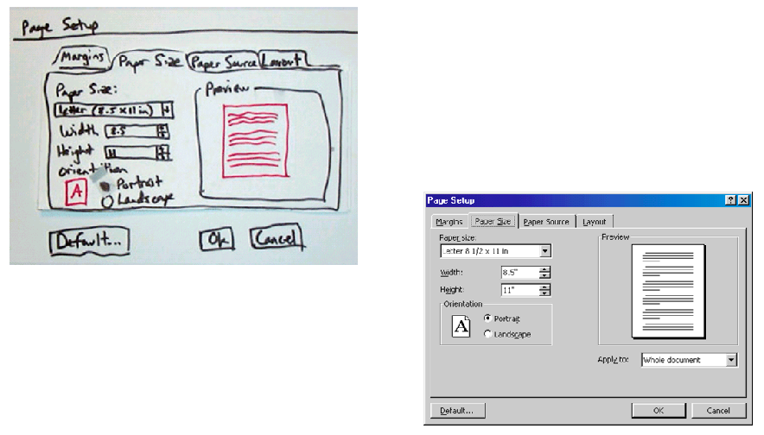
Prototype fidelity (cont’d)

Slide 9
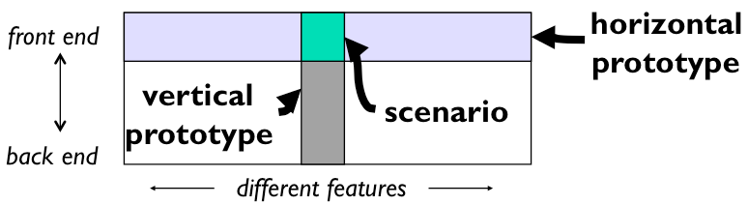
Dimensions of fidelity
Horizontal
  Prototypes cover many features but with little detail
Vertical
  Prototypes cover few features but with much in detail
Diagonal
  Prototypes cover down to a certain level and vertical

Slide 10
Dimensions of fidelity (cont’d)
Look
  Is the appearance and graphic design of the UI
  Can be sketchy and hand-drawn
Feel
  Referring to input methods to interact with the UI
  Pointing and writing (in paper-mockup) is different from mouse and keyboard
Can paper prototype have the feel attribute?

Slide 11
Paper prototype - Videos
“Example Usability Test with a Paper Prototype”
“Hanmail Paper Prototype”
“Paper prototype usability test”
Find these videos on Youtube

Slide 12
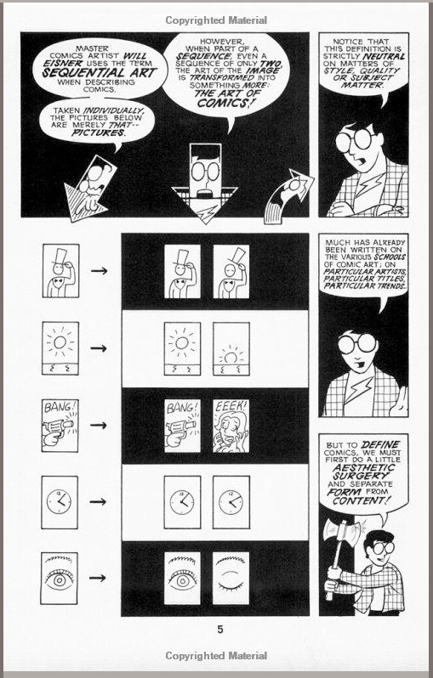
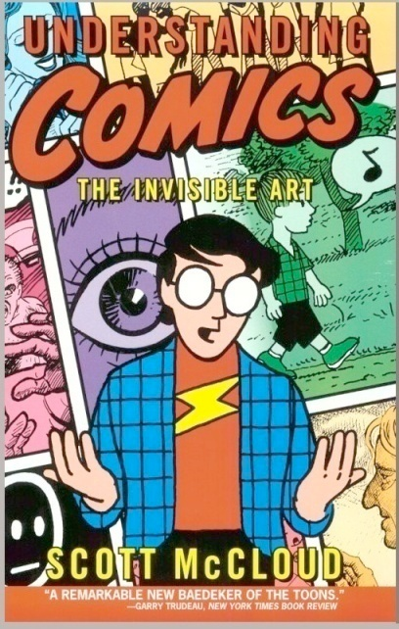
Storyboarding
Quick
Versatile
Powerful
Usability Engineering
Notes:
A very simple way to prototype an interface is to create a storyboard.
A storyboard is like a comic strip or comic book. It’s a series of panels that tells a story in pictures. It’s a quick, versatile, and powerful way to give people a sense of how an interface will work.
Scott McCloud’d book “Understanding Comics” is a great way to understand the language of storyboarding. We have it on reserve in the NUS library if you want to have a look.
Text source: Scott Klemmer (CS147, Fall 2010)
Images source: Understanding Comics, by Scott McCloud (a copy of this is on reserve in the NUS library)

Slide 13
Decide What to Include
1) Users
2) System
3) Brainstorm in team
4) Actor & artifacts & key events
5) Draw
Notes:
Understand users, their backgrounds, and goals.
Understand the system and its features.
Put together a design team and brainstorm about the storyboard, preferably using a large whiteboard.
Identify people and artifacts in the storyboard.
Develop the storyboard scenarios.

Slide 14
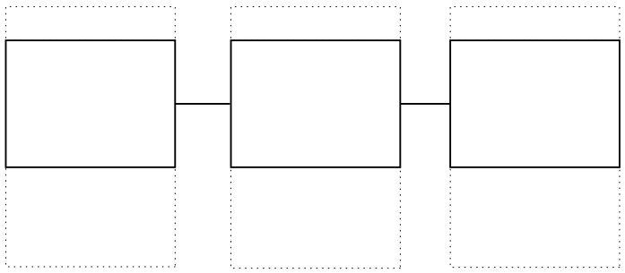
Build the Storyboard
Key frames (sentence description + drawing)
Caption
Annotation
Template: http://web.mit.edu/2.744/www/Project/Assignments/userExperienceDesign/storyboard_template1.pdf
Notes:
Break the story into smaller sections called frames or panes: Identify key "frames" from the scenarios while focusing each frame on an individual feature. Describe each frame in a short sentence. Draw a picture corresponding to each of these sentences.

Slide 15
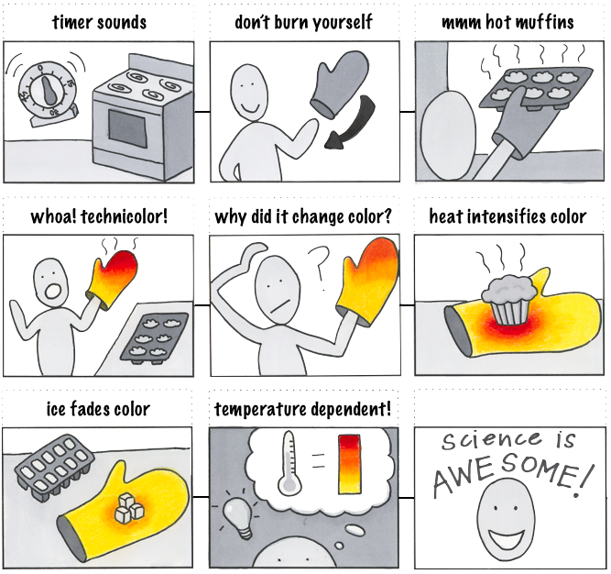
Creating Storyboards
Notes:
Here are some example storyboards for inspiration.
Why this storyboard is good: it’s simple, with clear focus, clean. It leaves a lot of imagination to designers.

Slide 16
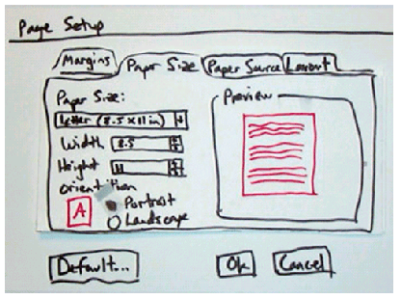
Paper prototype
Using paper mockup to represent the UI
  Sketches of screen appearance
  Paper pieces show windows, menus,
  dialog boxes, toolbars

Slide 17
Paper prototype (cont’d)
Interaction
  Pointing with a finger = mouse click
  Writing = typing
A person simulates the computer’s operation
  Putting down and picking up pieces
  Writing responses on the mockup (screen)
  Describing effects that are hard to show on paper

Slide 18
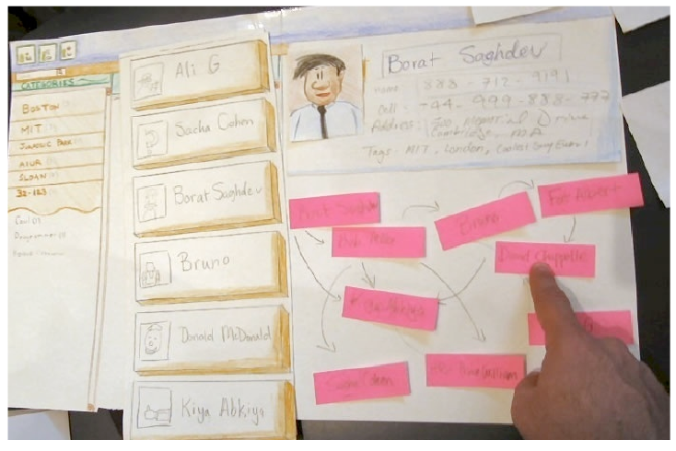
Paper prototype (cont’d)

Slide 19
Paper prototype (cont’d)
Characteristics
  Low fidelity in look and feel
  High fidelity in depth as there is person to simulate the operation

Slide 20
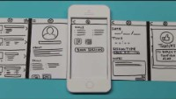
https://www.youtube.com/watch?v=y20E3qBmHpg

Slide 21
Paper prototype (cont’d)
Advantages
  Faster to build
  Easier to change
  Cheap
  Focuses attention on big picture
    Designers don’t waste time on details
    Attract ideas from customers
  Non-programmers can help
  Convenient
    You can prototype on the bus
    You can utilize your time efficiently

Slide 22
Tools for paper prototyping
White poster board
  Used as background or window frame
Index cards
Re-stickable glue
White correction type
Photocopier
  For making copies
Pens, markers, scissors, type
Etc.

Slide 23
Exercise
Work on paper prototypes for your app
  1 – 2 main screens
Take photos of your protoype and share
Time: 15 minutes

Slide 24
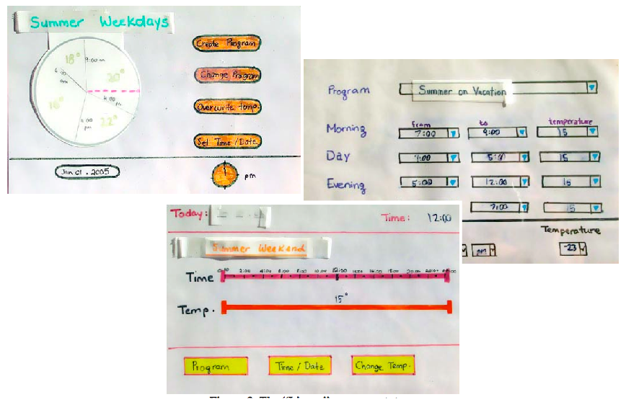
Tips for good paper prototypes
Make it large
Make it monochrome (single color)
Use description where necessary
  You cannot represent tricky interactions like drag & drop, animation, progress bar
Keep pieces organized
  Use folders and envelopes
Produce multiple alternatives
  Better to get feedback

Slide 25
What can paper prototypes help?
It helps better understanding of
  conceptual model
    Do users understand the UI?
  functionality of the system
    What features are missing in the UI?
  navigation and task flow
    Do users understand the navigation of the UI?
  terminology
    Are terms and levels understood?
  screen content and layout
    What are there in the UI?

Slide 26
What it does not help?
Showing “look”: color, font, whitespace, etc.
Demonstrating “feel”: efficiency issues
  Interactions are in low fidelity (not real)
Measuring response time
Demonstrating animation and high-level of interaction
  Actions like drag and drop, drawing, etc.

Slide 27
Computer prototype
Interactive software simulation
High-fidelity in look & feel
Low-fidelity in depth
  May be no backend, covering horizontally
  Does not have a human simulating the backend like paper prototype

Slide 28
What can computer prototypes help?
Everything from paper prototypes, plus
Better and higher-fidelity look
  Screen layout
  Colors, fonts, icons, etc.
  Choices of controls
Interactive feedback
Efficient issues
  Controls are big enough?
  Whitespace?
  Distance between controls?

Slide 29
Advantages of computer prototype
Faster than coding
No debugging
Easier to change and throw away
Separate UI design ideas from what offered by UI toolkit (e.g., Visual Studios, C++ Builder)
  Your thinking is not limited to available widgets
Non-programmers can do it

Slide 30
Computer prototyping techniques
Storyboard
  Sequence of painted screenshots, sometimes connected with links
Form builder
  Creating real windows with widgets such as buttons, windows, labels, etc.)
Wizard of Oz
  Computer frontend, human backend

Slide 31
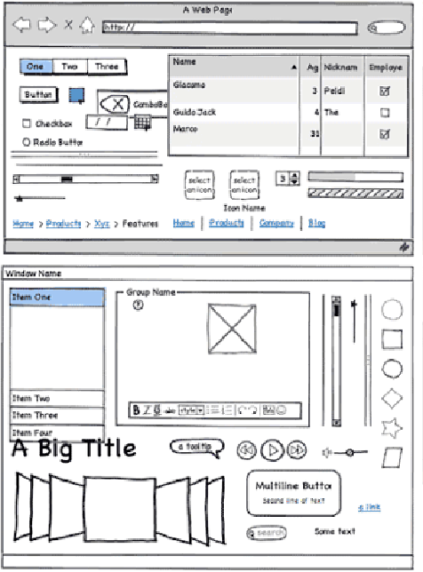
Computer prototyping techniques (cont’d)
Storyboarding tools
  Figma
  Powerpoint
  invision
  Photoshop
  Balsamiq Mockup
  Mockingbird
  Justinmind
  Axure
  Pidoco
  Excel
  Visio
  Etc.

Slide 32
Computer prototyping techniques (cont’d)
Storyboarding tools
  Pros
    You can draw anything
    Fast
  Cons
    No or limited interaction
      No text entry
      Widgets aren’t active

Slide 33
Computer prototyping techniques (cont’d)
Form builders
  FlexBuilder
  Silverlight
  Visual Basic
  C++ Builder
  Visual C#
  Qt Designer

Slide 34
Computer prototyping techniques (cont’d)
Form builders
  Pros
    Actual controls → high-fidelity in terms of look
    You can reuse the design for implementation → save effort from doing again
  Cons
    Limits thinking to standard and available widgets
    Content in each widget is not visible

Slide 35
Computer prototyping techniques (cont’d)
Wizard of Oz
  “Wizard of Oz” = “man behind the curtain”
  Software simulation with human in the loop to help
    Human “wizard” mimics computational functionalities
      system response interprets user input
      controls computer to simulate appropriate output
    Wizard is not always hidden
  Example
    Simulate the speech recognition which is not available (human is needed to recognize speech)

Slide 36
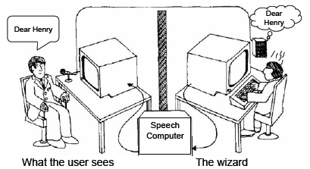
Computer prototyping techniques (cont’d)
Wizard of Oz
  Faking the interaction
  Issues
    Wizard has to be mechanical (pretending to be non-human)
    Worry about both UIs: for wizard and users

Slide 37
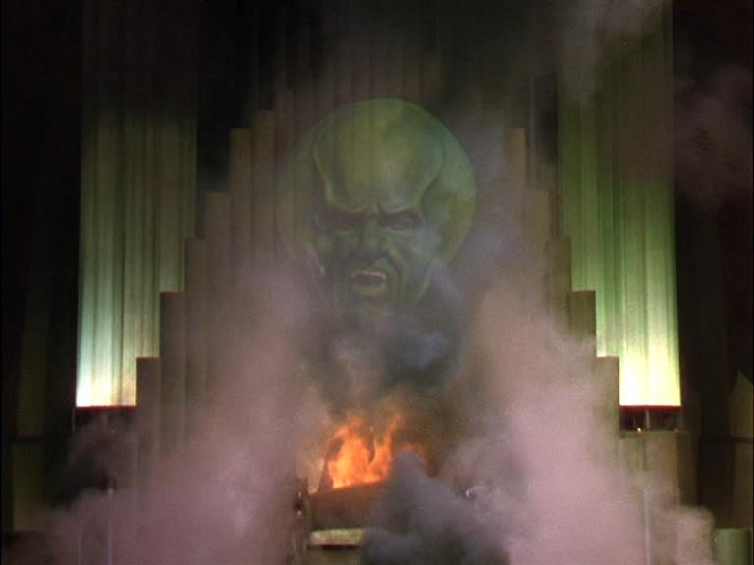
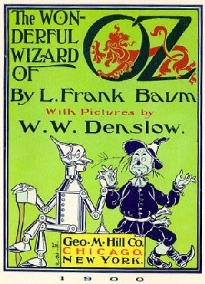
Notes:
Wizard of Oz is a powerful prototyping approach that is worth considering.
In the Wizard of Oz, Dorothy is whisked away by a tornado to a magical land called Oz. She’s told that the only person who can get her home is the “Wizard of Oz,” so she goes on a quest to find the wizard (along with a tin man, a scarecrow, and a cowardly lion). When she finally meets the Wizard, she finds this impressive-looking floating green head that everybody is afraid of. But…
Text adapted from: http://en.wikipedia.org/wiki/Wizard_of_Oz_experiment
Image 1 source: http://www.uktheatretickets.co.uk/shows/The-Wizard-of-Oz-Tickets
Image 2 source: http://thewizardofoz.info/

Slide 38
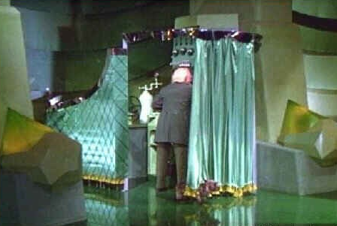
Notes:
… when Dorothy’s dog Toto pulls back a screen in a corner of the room, she finds a very unimpressive old guy controlling the floating green head with dials and levers. There’s the REAL Wizard!
John F. ("Jeff") Kelley used the terms "Wizard of OZ" and "OZ Paradigm" to describe the prototyping method he developed while doing his dissertation work at The Johns Hopkins University around 1980. (John’s dissertation advisor was Professor Alphonse Chapanis, the "Godfather of Human Factors and Engineering Psychology").
Jeff was working on speech recognition systems, and he had a problem. He needed to know how the interface would work before he would know what words the system should recognize. But he needed the recognizer to work before he could try out a user interface design!
Jeff’s solution was build a prototype that looked like a complete system, but it actually had a human being playing the part of the recognizer. This allowed Jeff to try out user interface designs before he had a working recognizer.
So you see, you can give users an interface that looks very impressive, even though it’s being controlled by a “man behind a curtain.” Amusingly enough, Jeff’s study actually had a curtain separating him (the "Wizard“), from view during the study.
Text adapted from: http://en.wikipedia.org/wiki/Wizard_of_Oz_experiment
Image 1 source: http://acidemic.blogspot.com/2010/07/great-acid-cinema-wizard-of-oz-1939.html

Slide 39
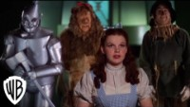
https://www.youtube.com/watch?v=-RQxD4Ff7dY

Slide 40
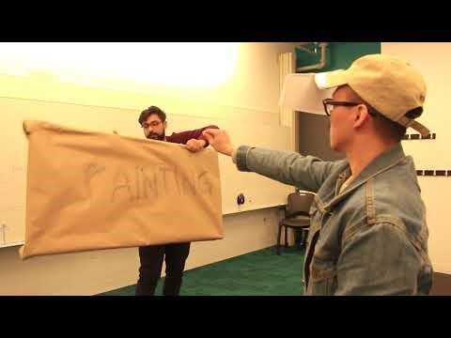
https://www.youtube.com/watch?v=yYIdT0cunhI

Slide 41
Exercise 2
Work with your project team
Discuss with your team mates to select the best paper prototype
Convert the selected paper protoype into computer prototypes using a software tool
25 minutes
Present 5 minutes each

Slide 42
Exercise 3
Work individually
Let’s sketch a virtual tourist assistant for Independence Palace.
15 minutes
Present 5 minutes each

Slide 43
Summary
Prototype
  Low- and High-fidelity
  Dimensions of fidelity
Paper prototype
Computer prototype
  Storyboard
  Form builder
  Wizard of Oz

